Slide 1

Optimizing Healthcare Provision through Data Analysis

Slide 2

TABLE OF CONTENTS
INTRODUCTION
PROJECT OVERVIEW
RESEARCH QUESTIONS
METHODOLOGY
RESULT FINDINGS
POWER BI DASHBOARD
CONCLUSION
RECOMMENDATION

Slide 3

INTRODUCTION

Slide 4

Imagine a healthcare system where data driven decisions drive better patient outcomes, improved resource allocation, and reduced costs. A system where healthcare providers can predict patient needs, prevent readmissions and optimize treatment plans. As we navigate the complexities of healthcare, its essential to uncover hidden patterns, trends, and insights that can inform our decisions. In this presentation, we’ll explore a real-world project that demonstrates how data analysis can transform healthcare provision. From revenue management to patient care, we’ll dive into the insights and recommendations that can help healthcare organizations thrive in a rapidly changing landscape.

Slide 5

PROJECT OVERVIEW
Analyze revenue management and cost optimization opportunities
Identify trends in patient care and outcomes
Evaluate departmental performance and resource allocation
Develop data driven strategies for growth and improvement

Slide 6
RESEARCH QUESTIONS
What is the total amount billed across all visits ?
What is the total amount covered by Insurance ?
What is the total Cost of medications prescribed?
What are the total cost of hospital stays ?
What is the total cost of treatments provided?
What are the total amount of patients that paid out of pocket ?
Identify which procedures generate the most revenue
Understand which diagnoses and service types generate the most revenue
Identify which departments generate the most revenue

Slide 7



Methodology
Data Source
Data Cleaning
Data Visualization
GitHub
Power BI
PowerPoint

Slide 8
Result Findings

Slide 9
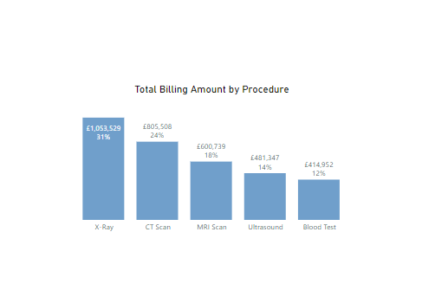
Which procedure generated the most revenue?
X-ray generated the most revenue

Slide 10
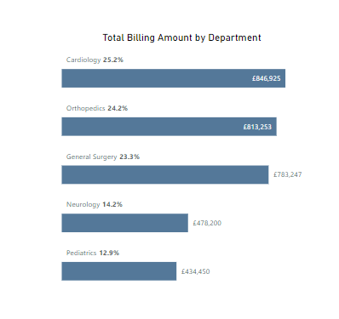
What department generated the most revenue?
Cardiology department generated the most revenue

Slide 11
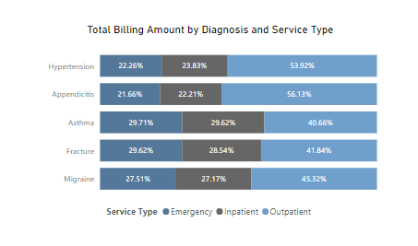
What diagnoses or service types generated the most revenue?
Outpatients generated the most revenue to the healthcare system

Slide 12
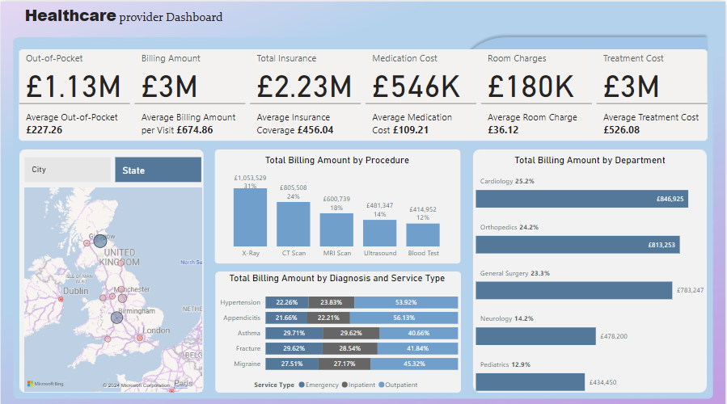
DASHBOARD

Slide 13

CONCLUSION
In conclusion, this project shows how essential data analysis is in Healthcare provision. By unlocking insights from data, we can improve patient outcomes, reduce costs, and enhance the overall efficiency of health care services.

Slide 14
RECOMMENDATION
In order to optimize billing process, it should be streamlined to reduce errors and increase efficiency, potentially increasing revenue by 5-10%
We could renegotiate contracts with suppliers to reduce medication costs, room charges and treatment costs, potentially saving 10-15% on expenses incured
We should reassess departmental resources and allocate them more efficiently, potentially increasing productivity by 10-15%
We should analyze and optimize procedure schedules as this would help in potentially increasing revenue by 5-10%
Always regularly analyze data to monitor progress, identify areas for improvement and inform strategic decisions.
We should also allocate resources to improve patients outcomes , potentially increasing patient satisfaction and loyalty

